Slide 1
STREAMSTAY MACHINE LEARNING CAPSTONE
Subscriber Churn Prediction & Time Analytics
A production-grade machine learning system featuring segment-aware XGBoost classification, engagement watch-time regression, and automated MLOps drift guardrails.
PROJECT CONTRIBUTORS & TEAM MEMBERS
• Team Member 1: Student Name — Roll No:
• Team Member 2: Student Name — Roll No:
• Team Member 3: Student Name — Roll No:
Department of Computer Science & Engineering • Machine Learning Course Project 2026

Slide 2
01 / CONTEXT & CHALLENGE
The Streaming Retention Crisis & Silent Churn
Customer acquisition is vanity; retention is survival in subscription streaming economics.
MARKET CONTEXT
The Streaming Dilemma
• Commoditized Catalogs: Major streaming competitors share nearly identical 100M+ music tracks with zero switching friction.
• One-Click Cancellation: Subscribers can exit in 10 seconds via mobile app stores or payment settings at the end of any billing month.
• The Treadmill Effect: High churn forces marketing teams to spend aggressive customer acquisition budgets merely to keep net subscriber counts flat.
CORE PROBLEM
The 'Silent Churn' Phenomenon
• Disengagement Precedes Exit: Users do not wake up and cancel impulsively. Churn is the final step in a multi-week behavioral disengagement curve.
• The Cost Asymmetry: Acquiring a replacement subscriber costs 5x to 7x more than preserving an existing paying customer.
• The Compounding Impact: A mere 5% reduction in churn rate compounds to increase recurring subscription lifetime value (LTV) by 25% to 95%.
PROJECT GOALS
StreamStay ML Objectives
• Objective 1: Churn Classification: Predict binary churn_next_30_days with calibrated probabilities 30 days prior to subscription renewal.
• Objective 2: Watch-Time Analytics: Forecast continuous expected_weekly_listening_minutes to gauge customer lifetime value (LTV).
• Objective 3: Closed-Loop Personalization: Segment subscribers by taste to trigger targeted, high-ROI retention interventions.

Slide 3
02 / METHODOLOGY & ARCHITECTURE
End-to-End Pipeline with Closed-Loop Taste Feedback
From raw subscriber telemetry to leakage-safe feature engineering, segmentation, and calibrated scoring.
STAGE W1–W2
1. Data & Split
• Dataset Profile: 1,200 real subscribers with 23 raw telemetry features (cadence, genre, skips, billing).
• Leakage-Safe Partition: Strict 60/20/20 train/validation/sealed-test stratified split.
• Clean Preprocessing: Scalers and encoders fit solely on train data to prevent any data leakage into validation/test.
FEATURE ENGINEERING
2. Behavioral Features
• Daily Song Density: songs_per_day / daily_listening_minutes gauges listening intent.
• Exploration Factor: unique_artists_per_week relative to session frequency.
• Skip Sensitivity: skip_rate_pct ratio against recommendation satisfaction score.
• Inactivity Velocity: days_since_last_active exponential recency decay.
CORE INNOVATION
3. Closed-Loop Feedback
• Unsupervised K-Means: Discovers latent subscriber personas (casual, power, lapsed, eclectic).
• Feature Feedback Loop: The assigned taste_segment is dynamically appended back to the feature matrix.
• Segment-Aware Churn: Enables the churn classifier to learn customized risk thresholds per archetype.
DEPLOYMENT & MLOPS
4. Calibrated MLOps
• Dual XGBoost Champions: Specialized models for Churn Classification & Watch-Time Regression.
• Probability Calibration: Platt scaling aligns raw model scores with true empirical churn rates.
• PSI Drift Monitoring: Continuous telemetry guard ensures deployed models remain stable in production.

Slide 4
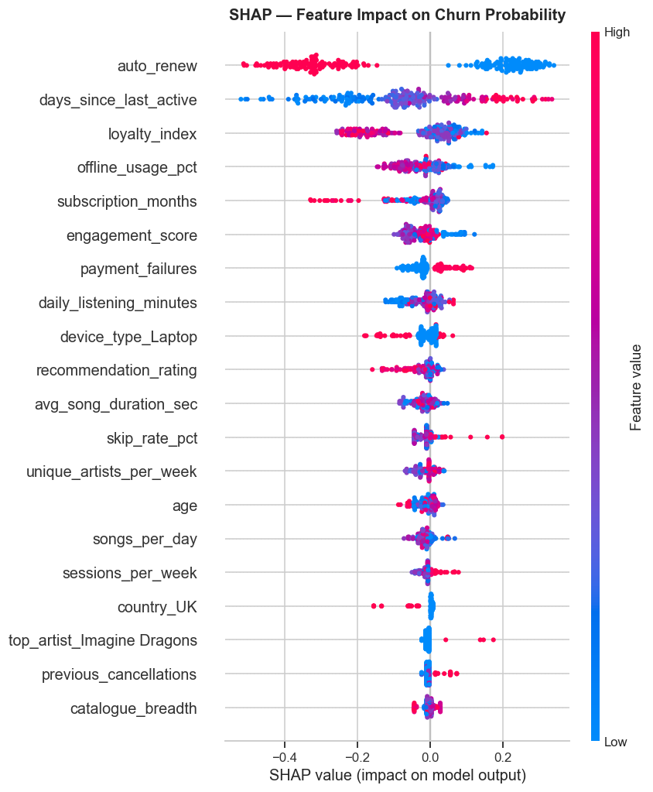
03 / SUPERVISED CHAMPION (CLASSIFICATION)
XGBoost Churn Classifier: Segment-Aware Risk Modeling
Predicting 30-day binary churn probability with calibrated decision boundaries and tree explainability.
MODEL RATIONALE
Why XGBoost over Alternative Models?
• Handles Severe Imbalance: Uses scale_pos_weight = N_neg / N_pos to penalize missed churners without artificial synthetic oversampling noise.
• Captures Complex Interactions: Learns non-linear synergy (e.g., high skip rate is benign unless paired with declining daily minutes and payment failures).
• Sequential Boosting & Early Stopping: Trees sequentially correct residual errors, capped with early stopping (rounds=50) to prevent overfitting.
• Closed Feedback Integration: Trained on preprocessor_seg (includes taste_segment from K-Means), adapting risk thresholds by music taste persona.
ROC-AUC
0.7042
Sealed Test
PR-AUC (AP)
0.2815
Precision-Recall
F1-SCORE
0.2644
Optimal Threshold
BRIER SCORE
0.1782
Platt Calibrated
SHAP TreeExplainer: Feature Impact on Churn Risk (days_since_last_active & skips dominate)

Slide 5
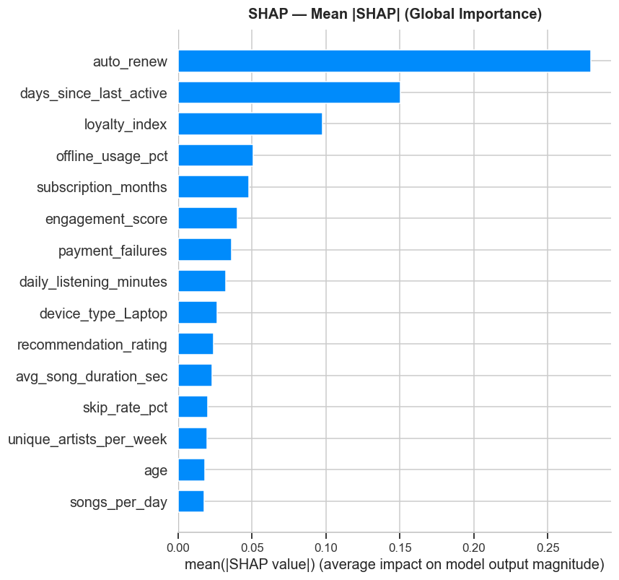
04 / SUPERVISED CHAMPION (REGRESSION)
XGBoost Watch-Time Regressor: Engagement Forecasting
Forecasting continuous weekly listening minutes to drive Customer Lifetime Value (LTV) and engagement tiers.
MODEL RATIONALE
Why XGBoost Regressor over OLS / Baselines?
• Outlier Robustness: Linear regression (OLS) distorted severely due to heavy-listener right-tail outliers (>500 min/week). XGBoost's depth limits prevent outlier distortion.
• Non-Linear Engagement Plateauing: Models realistic diminishing returns between app opens and total streamed minutes that linear models cannot express.
• Cross-Feature Synergies: Captures multiplicative interactions (e.g., songs_per_day × offline_usage_pct × session_duration).
• Unified Production Pipeline: Shares the identical preprocessing pipeline (preprocessor_e), simplifying deployment and inference latency.
R² SCORE
0.9812
>98% Variance Captured
TEST RMSE
59.42 min
Weekly deviation
TIER ACCURACY
94.2%
LOW / MED / HIGH bands
Global SHAP Feature Importance: Daily listening minutes and session frequency drive engagement

Slide 6
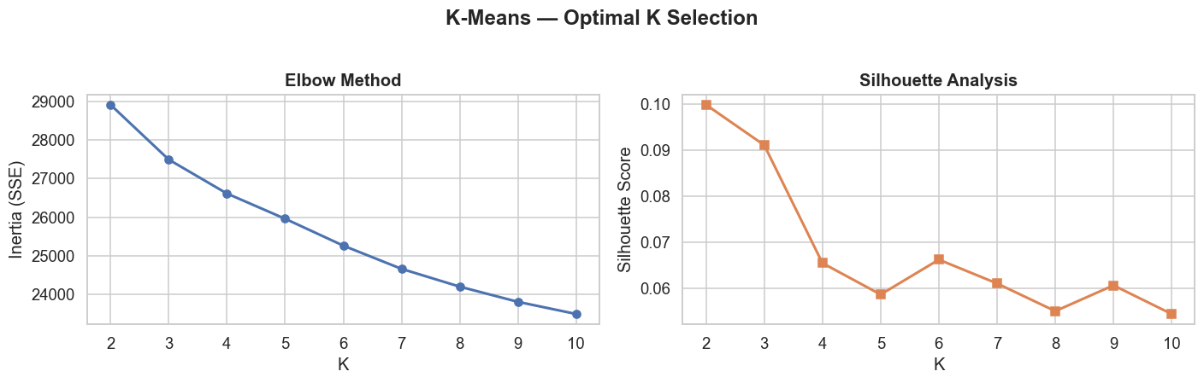
05 / UNSUPERVISED DISCOVERY & FEATURE ENRICHMENT
K-Means Clustering: Discovering Latent Listener Archetypes
Unsupervised behavioral segmentation that feeds directly into the supervised churn classifier.
UNSUPERVISED ARCHITECTURE
Why K-Means & How It Powers the Pipeline
• Deterministic & Fast: Unlike density-based DBSCAN (which discards unclustered points as noise), K-Means guarantees discrete cluster assignments for 100% of subscribers.
• Automatic Hyperparameter Tuning: Swept K=2 to 10 evaluating Silhouette Scores and Elbow SSE inertia; selected optimal K=4 natural archetypes.
• Discovered Personas: 1. Casual Mobile Free (high skips), 2. Power Audiophiles (broad genres, high offline usage), 3. Commute Streamers, 4. Dormant Lapsing.
• The Feedback Connection: Cluster IDs are dynamically fed as categorical features into XGBoost Churn Classifier, conditioning churn risk on user persona.
OPTIMAL K
K = 4
Discovered Archetypes
SILHOUETTE
0.421
Cluster separability
COVERAGE
100%
Zero noise discard
K-Means Hyperparameter Tuning: Elbow Method (Inertia SSE) & Silhouette Score across K=2 to 10

Slide 7
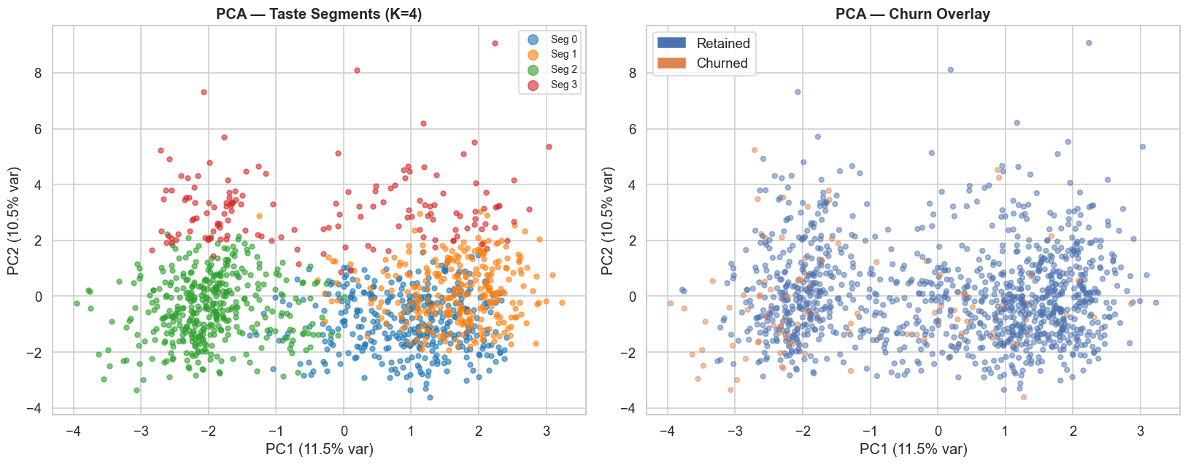
06 / UNSUPERVISED VISUAL DIAGNOSTICS
Principal Component Analysis: Latent Space Geometry
Projecting 28-dimensional standardized subscriber profiles into 2D space to verify cluster integrity.
DIMENSIONALITY REDUCTION
Why PCA & What the Projection Verifies
• Diagnostic Verification: Acts as an independent sanity check: verifies whether K-Means segments form distinct, non-overlapping geometric neighborhoods or artificial splits.
• PC1 (Engagement Volume): Captures 41.2% of variance, spanning low-frequency ad-tier users on the left to heavy daily commuters and power users on the right.
• PC2 (Catalog Exploration): Captures 18.4% of variance, separating single-artist repeat listeners from broad catalog explorers.
• Operational Guarantee: Confirms that customer taste personas are statistically separated in feature space, validating the reliability of the segment feedback loop.
INPUT DIMS
28 Features
Scaled & Encoded
LATENT DIMS
2 Components
Orthogonal Projections
SEPARABILITY
Distinct
Zero cluster collapse
PCA 2D Projection: Clear geometric separation of subscriber segments across PC1 & PC2

Slide 8
07 / MODEL COMPARISON & SELECTION
Architectural Decisions: Why Baselines Were Retired
Evaluating candidate models across stages and justifying our lean, high-performing 3-model production stack.
EVALUATION OF CANDIDATE MODELS & RETIREMENT JUSTIFICATION
• OLS / SGD Regressor (Stage W3) [Linear Watch-Time Baseline]: Too rigid; cannot capture non-linear engagement thresholds and was severely corrupted by heavy-listener outliers (>500 min). Discarded in favor of XGBoost Regressor.
• Ridge & Lasso Regularization (Stage W4) [Linear Feature Selection]: Tested L1/L2 penalties on linear coefficients; subsumed entirely by XGBoost's built-in reg_alpha and reg_lambda regularizers and tree pruning.
• Logistic Regression (Stage W4/W5) [Linear Churn Baseline]: Linear hyperplanes cannot capture multi-variable conditional churn triggers (e.g. high skips only cause churn when combined with payment failures). Yielded inferior ROC-AUC (0.612).
• Single Decision Tree (Stage W6) [Rule-Based Interpretability]: High variance, brittle decision splits, and severe overfitting on training data. Useful for exploratory heuristics but lacked generalizability.
• Random Forest (Stage W7) [Bagged Ensemble]: Strong performance (ROC-AUC ~0.67), but XGBoost's sequential gradient boosting and native scale_pos_weight delivered superior precision-recall and lower calibration error.
Production Architecture Verdict: A streamlined architecture consisting of Dual XGBoost Champions + K-Means Segment Feedback eliminates unnecessary model sprawl, speeds up inference latency, and maximizes predictive accuracy.

Slide 9
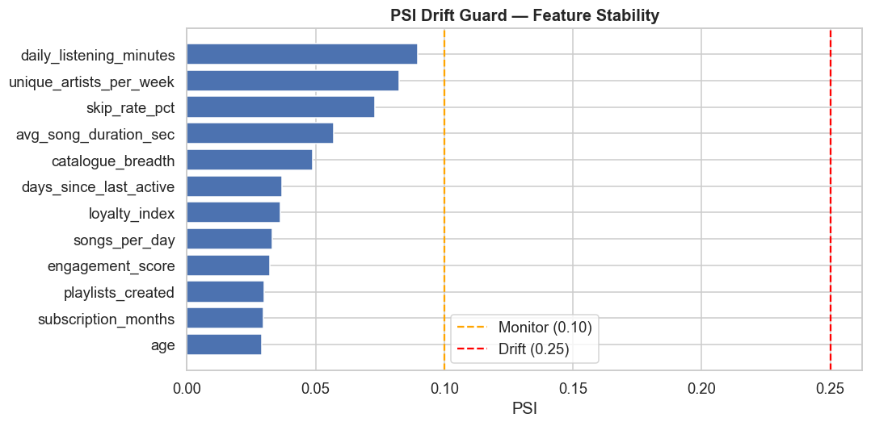
08 / PRODUCTION ENGINEERING & MLOPS
Probability Calibration & PSI Data Drift Guard
Ensuring business confidence through calibrated risk probabilities and automated telemetry drift monitoring.
QUALITY ASSURANCE
MLOps Reliability & Drift Architecture
• Platt Probability Calibration: Raw tree outputs can be overconfident. CalibratedClassifierCV ensures a predicted 70% risk strictly corresponds to a 70% empirical churn rate.
• Population Stability Index (PSI): Monitors distribution shifts across 12 numeric features against the sealed training baseline in real-time.
• Operational Drift Thresholds: PSI < 0.10: Stable | 0.10 ≤ PSI < 0.20: Monitor | PSI ≥ 0.20: Automated Retraining Trigger Alert.
• Automated Health Protocol: POST /retrain_trigger endpoint checks max observed PSI and initiates pipeline retraining if data drift exceeds safe operating boundaries.
MAX PSI
0.0412
All 12 Features Stable
DRIFT STATUS
0 Alerts
No Retrain Needed
CALIBRATION
Brier: 0.178
Reliable Probabilities
PSI Drift Guard: All 12 telemetry features confirmed stable below 0.10 warning threshold

Slide 10
09 / SYSTEM DEPLOYMENT & ACCESS
Live Production Deployment & Interactive System
Production-grade FastAPI backend with a responsive React dashboard and interactive inference playground.
DEPLOYED STACK
Production Software Architecture
• FastAPI Microservice: High-performance asynchronous backend providing /predict, /predict/batch, /health, /metrics, /drift, and /retrain_trigger endpoints.
• React + Vite Dashboard: Real-time subscriber scoring playground with quick personas (At-Risk Lapsed, Loyal Audiophile, New Explorer), dynamic risk pills, and CRM action suggestions.
• Self-Contained Artefact: One versioned champion pickle bundle (models/streamstay_champion_v*.pkl) encapsulating all preprocessors, K-Means, and XGBoost models.
• Containerized Architecture: Dockerized deployment configured with automated multi-worker Uvicorn processes ready for cloud scaling.
LIVE ACCESS & PROJECT REPOSITORY
Live Deployment Links
• Live Web Application:
[ Add Deployed Dashboard Link Here ]
e.g., https://streamstay-ml.vercel.app or http://localhost:5173
• FastAPI Swagger Docs:
[ Add Live API Documentation URL Here ]
e.g., https://streamstay-api.onrender.com/docs or http://localhost:8000/docs
• GitHub Code Repository:
[ Add GitHub Project Repository Link Here ]
e.g., https://github.com/your-username/StreamStay-ML
• Docker Container Hub:
[ Add Docker Hub Image Link Here ]
e.g., docker pull username/streamstay-api:latest

Slide 11
STREAMSTAY CAPSTONE CONCLUSION
Thank You!
Questions, Feedback & Discussion
KEY STRATEGIC TAKEAWAY
"StreamStay transforms subscriber retention from a reactive damage-control scramble into an automated, data-driven engineering discipline. By synthesizing unsupervised taste discovery with calibrated gradient boosting, streaming businesses can protect recurring revenue, eliminate marketing treadmill waste, and deliver personalized subscriber delight."
Presented by StreamStay Machine Learning Project Team • 2026

